Slide 1
Consultation on Liverpool’s Hospital-Based Orthopaedic and ENT Services for Adults
26 June to 15 September 2017

Slide 2
Recap on what is being proposed

Slide 3
Consultation Objectives
The objectives for the consultation were to:-
Increase understanding among patients and public of the issues prompting the review of Orthopaedic and ENT services
Share the potential solutions that have been considered in the review and present the preferred option.
Understand whether people recognise and support the reasons for changing how and where care is provided
Understand how the preferred option may impact on the local population and their views of the proposed change
Understand whether there are differences of view among different communities and whether any adjustments \ mitigations can be made to the proposed option, especially regarding meeting Equalities duties. The biggest difference for patients – in some cases - will be additional travel.
Provide people with a range of mechanisms to share their views about proposals for these services.

Slide 4
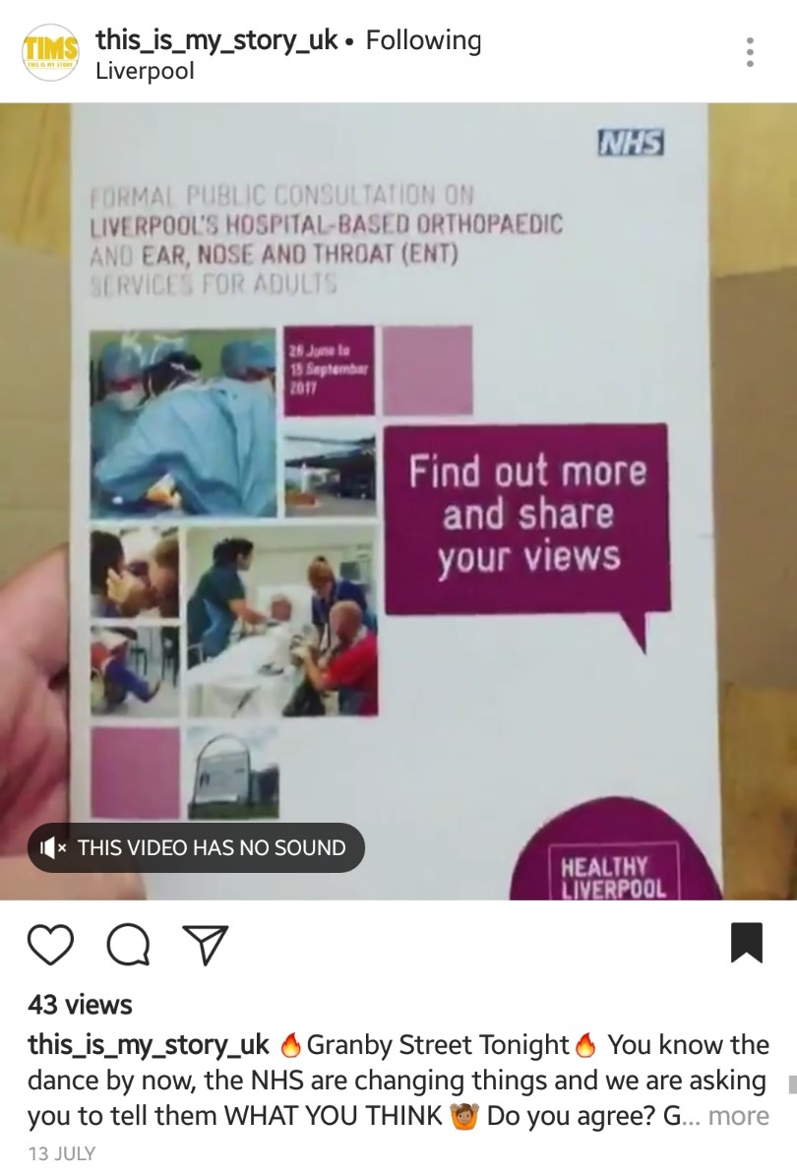
Consultation Format
Website and social media
Booklet
VCSE Engagement Partners
Public Events/ HealthWatch
Clinics
Using existing workforce

Slide 5
Consultation Reach
10,030 consultation booklets distributed
Trust volunteers gave out 3067 surveys and directly supported 364 people to complete the survey.
Online - 3,870 visits to the website
Facebook - 57,860 reach
Twitter - 94,204 impressions
6 Community Partner Engagement reaching approx. 600
20 community meetings
32 sessions with BME communities
22 community clinics
2 Healthwatch events
Direct letters – S&F patient’s only

Slide 6
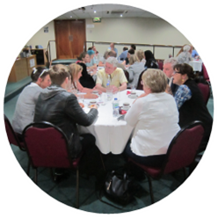
Consultation Findings
Overall, there were 2000 responses to the consultation ; 1757 received through a completed survey and 243 individuals involved in 19 focus groups.

Slide 7
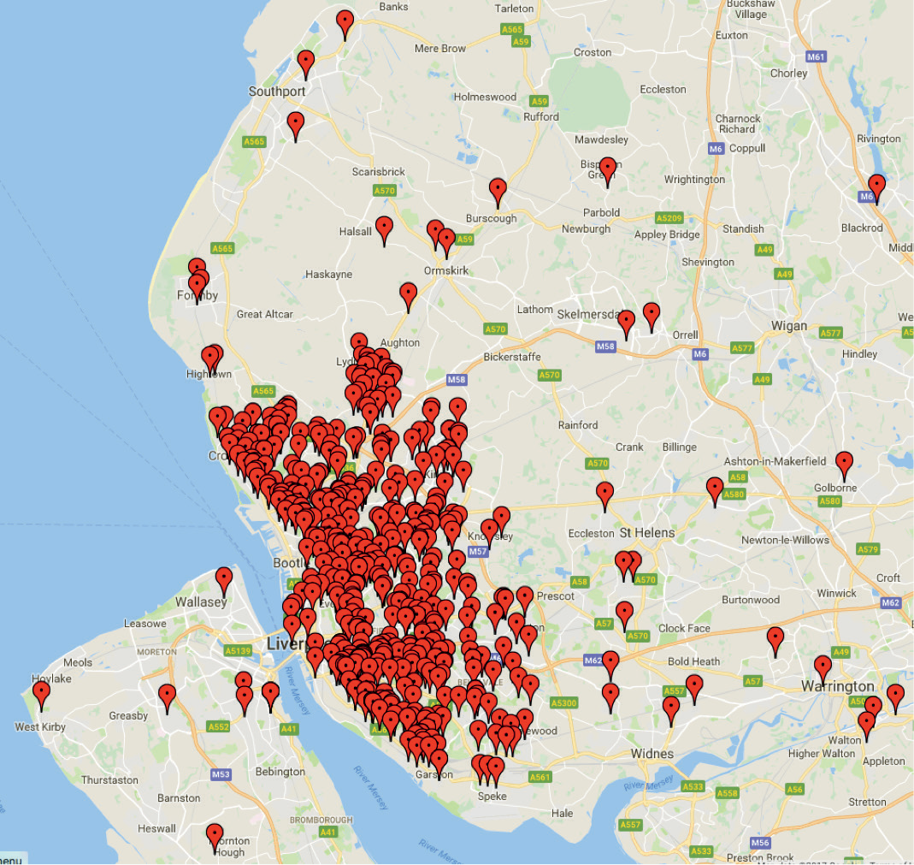
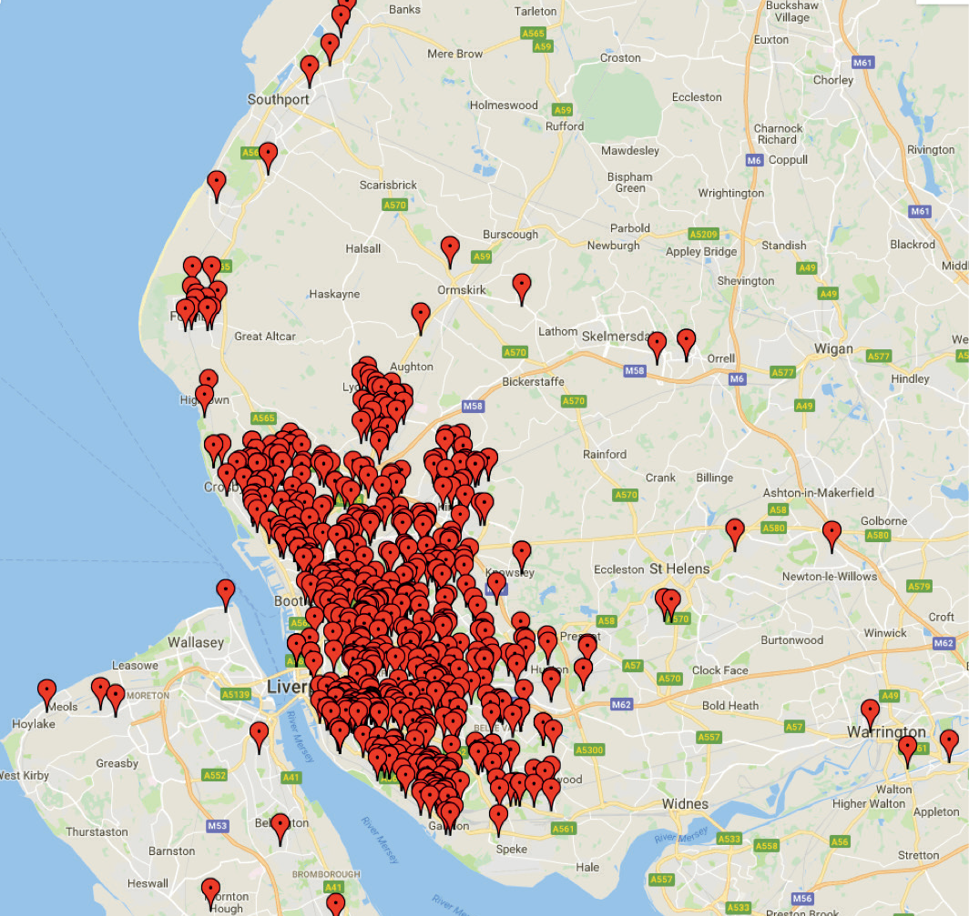
Relationship to services
Orthopaedic service users
ENT service users

Slide 8
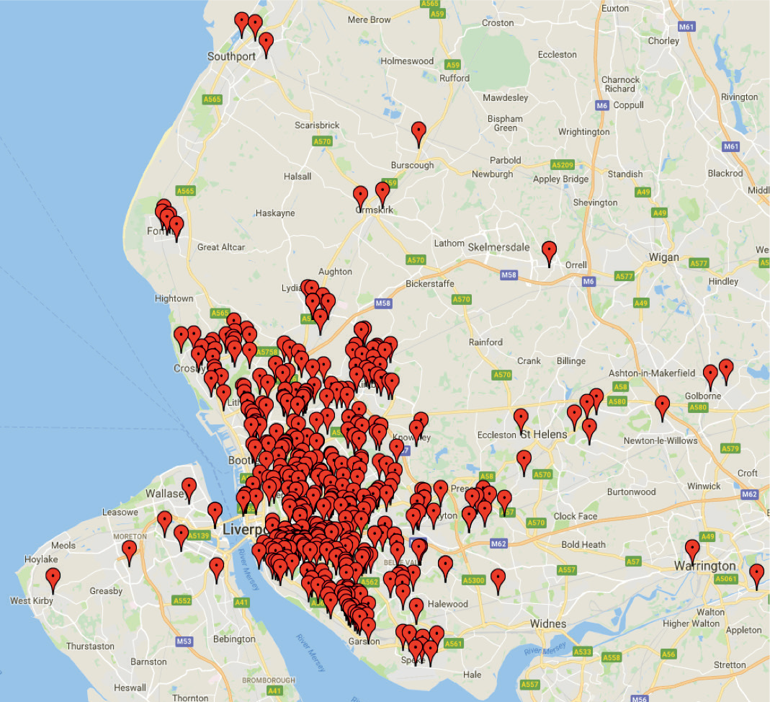
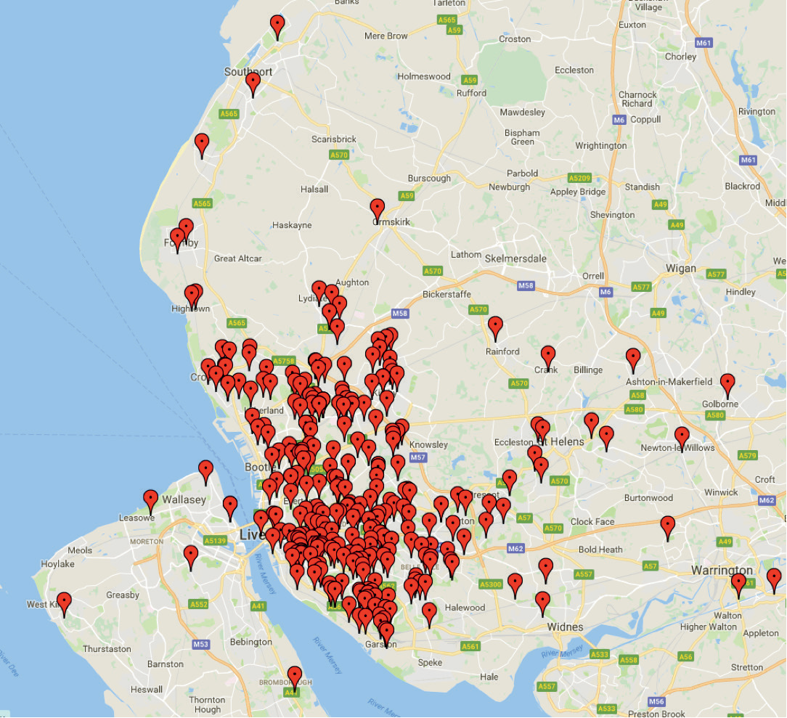
Relationship to service
Close to a service user
Works with service users

Slide 9
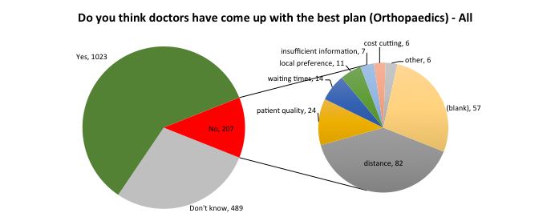
Consultation Findings
Do you think that the doctors have come up with the best plan for orthopaedics?

Slide 10
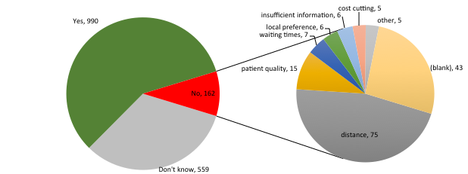
Consultation Findings
Do you think that the doctors have come up with the best plan for ENT?

Slide 11
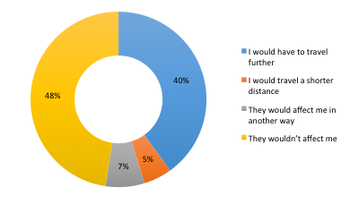
Consultation Findings
How might the changes affect you?

Slide 12
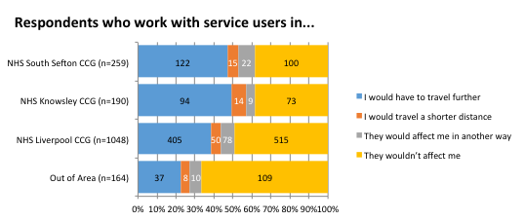
Consultation Findings
How might the changes affect you? - by region

Slide 13
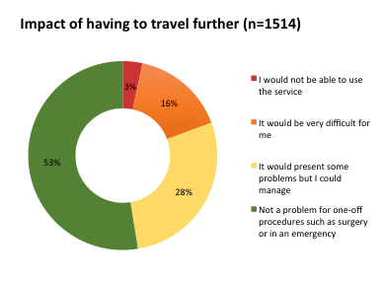
Consultation Findings
What would be the impact of travelling further to use services?

Slide 14
Impact of traveling by region

Slide 15
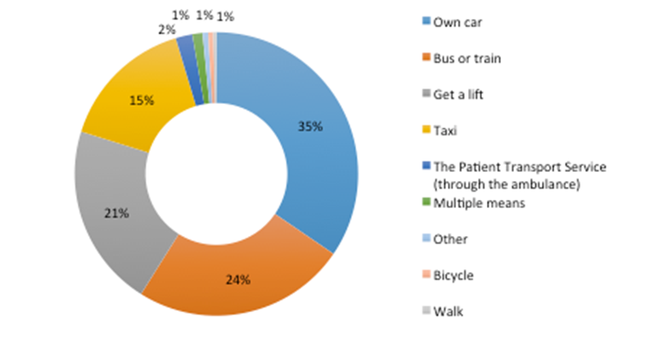
Consultation Findings
How would you travel to hospital for a planned procedure?

Slide 16
They haven’t thought about people with disabilities or mobility issues’ – Henshaws service user
this is a good proposal as long as they work hand in glove with Merseytravel and put on a decent bus service for people who live in the south end of the city and want to go to the north end.
Participants were worried that the changes may mean they incur travel costs that they couldn’t afford. - Mencap

Slide 17
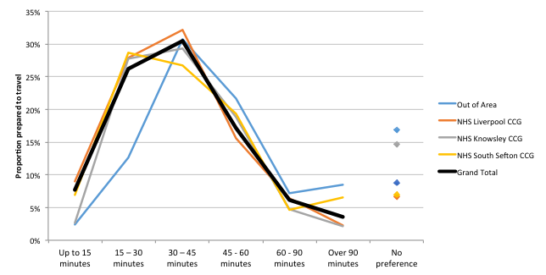
Consultation Findings
How long would you be prepared to travel for a planned procedure?

Slide 19
Mitigations
Issue | Mitigation
Concerns regarding impact on quality of care were mainly from South Sefton residents. | Further engagement with south sefton service users to understand perceptions around quality of care and how these could be addressed/reassurance offered. This can run in parallel with approval processes
Transport concerns | Immediate actions to include:- Merseytravel app embedded on each trusts webiste – offers access routes to hospital. Patient letters - include a reminder of how people can find information regarding travel options – i.e. link to Merseytravel and their phone number Have information available of criteria for accessing patient ambulance service Short-term • Staggered admissions and scheduling – opportunities for coproduction and can run in parallel with approvals process Monitoring DNA data by protected characteristics to ensure equality of acess
A change of service location can cause anxiety for individuals with learning disabilities | Use pre-op assessment proforma as a check for staff to flag up that patients with LD can go to the centre in advance to get used to the environment if they wish. This already happens in Aintree.

Slide 20
Next Steps
Full feasibility study to Royal and Aintree Board’s – End of Feb 18
Final stage 2 assurance from NHS England Stage – After board approval, March 18
CCG Joint Committee or Individual CCG Governing bodies – March 18 (subject to NHSE stage 2 assurance being obtained)
Joint OSC – TBC

Slide 21
Any Questions ?

