Slide 1
Welcome
Annual Review 2020-2021
15 September 2021
Follow us @NHSSFCCG

Slide 2
Introduction
Dr Rob Caudwell
Chair
NHS Southport and Formby CCG
Follow us @NHSSFCCG

Slide 3
About our event
Please stay on mute and turn cameras off while presentations are taking place
We are recording today’s event so it can be viewed at a later date from our website
Please don’t interrupt speakers, we’d invite you to use the hand and chat function and we will aim to get to you after each presentation. If we don’t get to you we are happy to answer questions after the event over email / phone

Slide 4
About our event
We are not having a Q&A session at the end but will ask for questions after each presentation. If there are any extra questions that we don’t get to please email communications@sefton.nhs.uk and we will respond after today’s event
For those that need it, there is a subtitles function on teams, you can turn this on by clicking the three dots at the to right of the screen and clicking ‘turn on live captions’

Slide 5
What we will cover
Introduction
Dr Rob Caudwell, chair
Our year and successes
Fiona Taylor, chief officer
Our performance 2020-2021
Martin McDowell, chief finance officer
Where we are now and where we are going
Fiona Taylor, chief officer
The future of health and care in Sefton
Eleanor Moulton, Sefton Council
Interactive session on general practice
Jan Leonard, director of place

Slide 6
Poll question

Slide 7
Our year and successes
Fiona Taylor
Chief officer
NHS Southport and Formby CCG
Follow us @NHSSFCCG

Slide 8
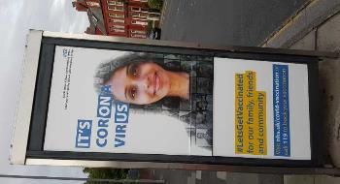

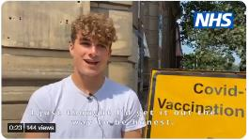

Some of our achievements
COVID-19
Organising our COVID-19 response and working with partners to keep our vulnerable patients safe
The volunteer programme working with Voluntary, Community and Faith sector and Primary Care Networks
The vaccination programme –86,757 first doses and 80,302 second doses (out of 125,538 residents)

Slide 9

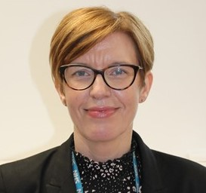
Some of our achievements
Sefton2gether – building on our system wide 5 year plan with partners including Sefton Council
Awards – Susanne Lynch MBE and shortlisted in Parliamentary awards
Annual rating – annual rating retained
/ highest level for public engagement
Care home forum – working with Sefton Council to build a successful enhanced care service for care home residents

Slide 10
How we involved you 2020-2021
Virtual AGM – we informed residents of the past year and the challenges we faced when the pandemic hit
Working with partners – collaborating with partners like Healthwatch Sefton and Sefton Council to promote the vaccination programme and to carry out research to help with vaccine hesitancy
Shaping Care Together – working with Southport and Ormskirk Hospital NHS Trust and NHS West Lancashire CCG to gather views of local health and care services
Improving language services in GP practices – we engaged on a single approach to improve language services across the borough

Slide 11
Some of our challenges
COVID-19 – a challenge for all and still ongoing
Financial challenges
Pressure on health and care services, in particular general practice
We weren’t able to engage as fully as we would have wanted

Slide 12
One shared vision
“A confident and connected borough that offers the things we all need to start, live and age well, where everyone has a fair chance of a positive and healthier future.”

Slide 13
Our transformation partners
NHS South Sefton CCG
Sefton Council
Mersey Care NHS Foundation Trust
Southport and Ormskirk NHS Hospital Trust
Liverpool University Hospital NHS Foundation Trust
Alder Hey Children’s Hospital NHS Foundation Trust
The Walton Centre
Liverpool Heart and Chest Hospital
Liverpool Women’s NHS Foundation Trust
Sefton Primary Care Networks
Sefton GP Federations
Voluntary, community and faith organisations
NHS West Lancashire CCG
NHS England and Improvement
Cheshire and Merseyside Health and Care Partnership
Lancashire and South Cumbria NHS Foundation Trust

Slide 14
Our performance 2020-2021
Martin McDowell
Chief finance officer
NHS Southport and Formby CCG
@NHSSFCCG

Slide 15
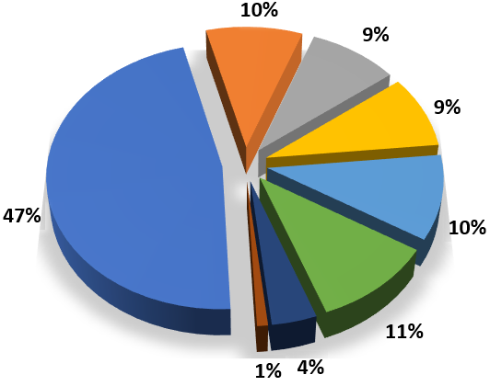
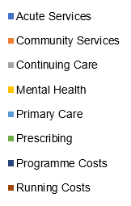
How we spent our money

Slide 16
Our performance 2020/21
We had a budget of £245 million equating to £1,951 for each Southport and Formby resident
At the end of the year the CCG reported a breakeven position for 2020/21 Financial Year – an improvement from the £12.8 million deficit reported in 2019/20.
The CCG external auditors issued an unqualified opinion on the CCG’s annual report and accounts

Slide 17
Improving performance
We work hard to continually improve services and areas of focus during 20/21 included:
Good progress to restore Elective services
(74.4% treated within 18 weeks v 64.4% national)
Important Mental Health Targets achieved
(First episode Psychosis and CPA follow-up)
50.4% of residents accessing IAPT (Talking Therapies) reported recovery through treatment
Cancer 31 day treatment target achieved
(96.2% v target of 96%)

Slide 18
Any questions?

Slide 19
Where we are now and where we are going
Fiona Taylor
Chief officer
NHS Southport and Formby CCG
Follow us @NHSSFCCG

Slide 20
Our future landscape
From April 2022 we will be part of a bigger, regional system – known as an integrated care system with Cheshire and Merseyside Health and Care Partnership
AND our work will continue to be rooted in our borough of Sefton – called our ‘place’ - working together with our community and local partners; Sefton Council, Primary Care Networks and voluntary community and faith groups to transform services for our residents

Slide 21
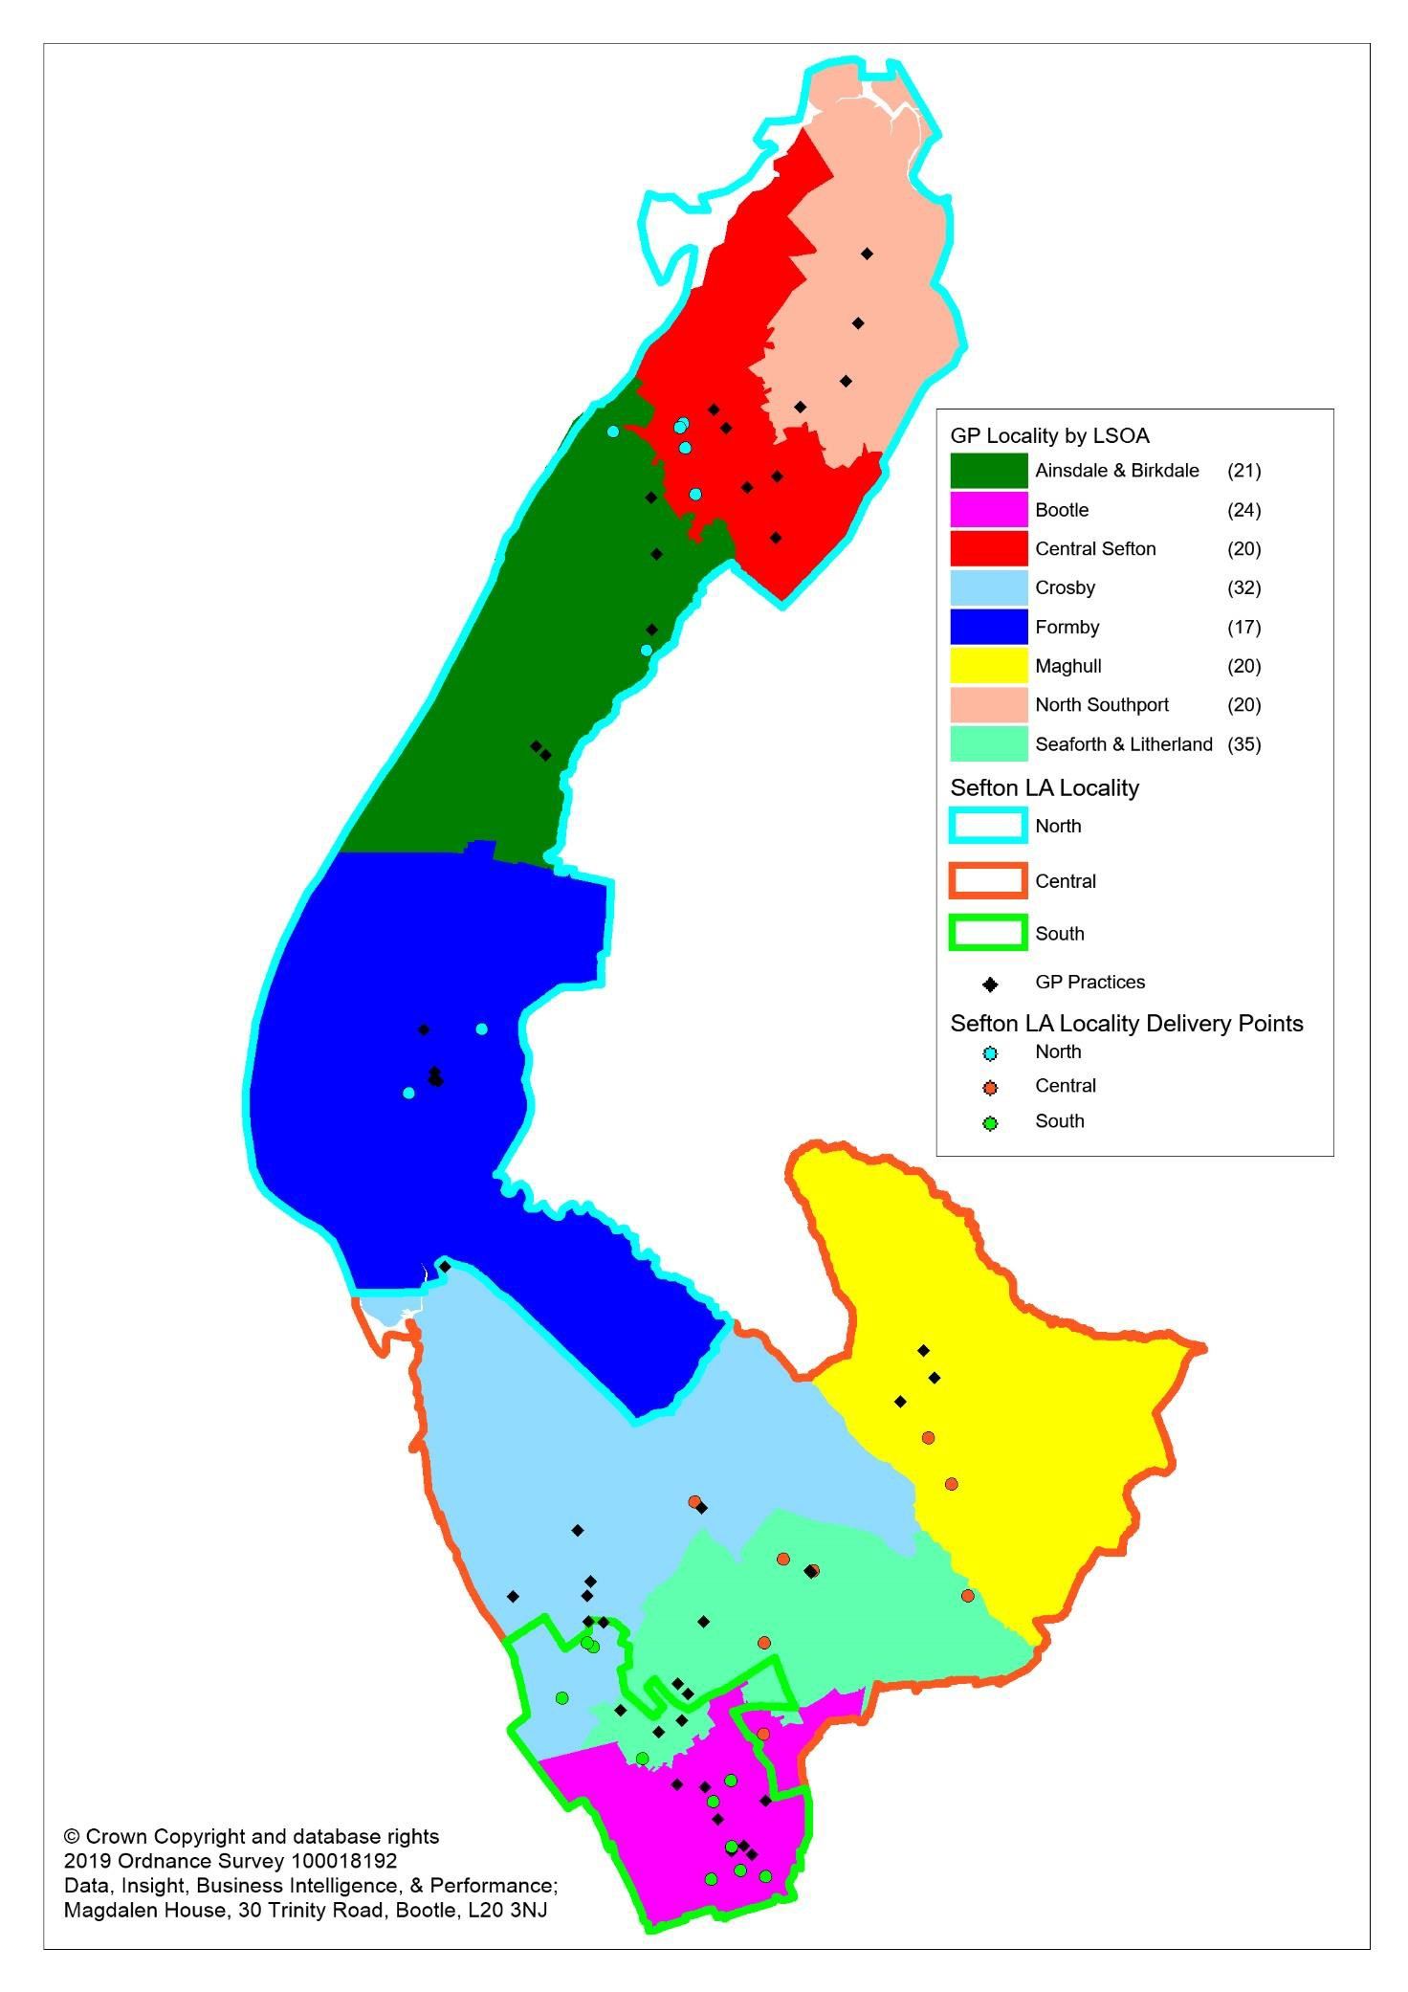

Sefton borough landscape
Sefton’s 8:3
Locality
Model
The North PCN is in the Council’s North locality
One PCN for Seaforth and Litherland
Notes:
The map highlights Sefton’s 8:3 locality model which includes:
8 Health localities covering 3 primary care networks (PCNs) based on 30-50,000 populations
3 council localities based on equalised demand and serving increasingly larger population footprints, from 55,000 in the south to 120,000+ in the north
4 health localities (with 1 coterminous PCN) in Southport & Formby and aligns to the council’s north locality (turquoise border)
4 health localities (with 2 PCNs) in south Sefton and align to the council’s central and south localities (orange and green borders)
Partner services are aligned to the 8 or 3 locality approach – the goal is to strengthen working relationships across partners so services are seamless or more integrated for local people

Slide 22
Sefton borough landscape
Localities and PCNs
Sefton 8:3 model
Council localities
South Locality
North Locality
Central Locality
PCNs
Southport and Formby PCN
Crosby, Bootle & Maghull PCN
Seaforth & Litherland PCN
Localities
(30-50k population)
North
Central
Ainsdale & Birkdale
Formby
Crosby
Maghull
Bootle
Seaforth & Litherland

Slide 23

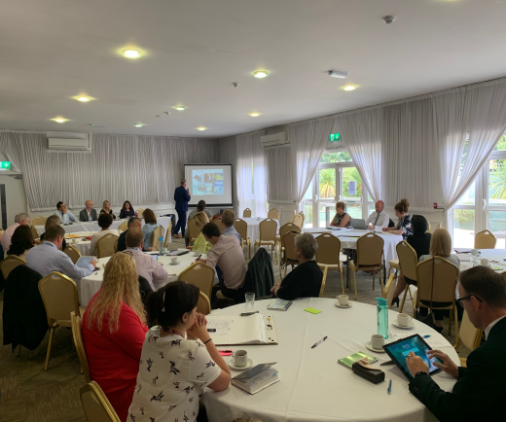
Our local focus
Primary Care Networks: Supporting development in line with the DES and local ambitions
Acute & Specialist Services: Working to develop sustainable delivery models
Sefton Provider Alliance: Supporting its development, capacity & capability to deliver
Sefton Council: Strengthening integration (delivery and commissioning)
80% delivery led within the Borough
20% delivery “at scale” across system

Slide 24
Our local focus
Neighbourhood (x 8 with 3 PCNs)
30-50,000
Community First Locality
(x 3)
55,000 – 120,000
80 %
Sefton
274,000
ICS
c2.5m
20 %
Notes:
Commissioning:
Leaner and more strategic; a key enabler for integration at place and sub-system levels is pooled budgets:
Integrated at place with the Council
Integrated at scale (across places) for acute services
Service Provision:
Based on “… footprints that respect patient flows”
Applying pareto’s law:
80% of service provision is expected to be within “place” and built upwards from PCNs. Place is the emerging footprint (in C&M) for an ICP with vertical integration and where population health management is embedded
20% of service provision is “at scale” supporting acute collaboration across places and new acute provider group models as per Salford and Warks

Slide 25
Any questions?

Slide 26
The future of health and care
(see separate slides)
Eleanor Moulton
Sefton Council
Follow us @NHSSFCCG

Slide 27
General practice in Sefton
Jan Leonard
Director of place
NHS Southport and Formby CCG
Follow us @NHSSFCCG

Slide 28
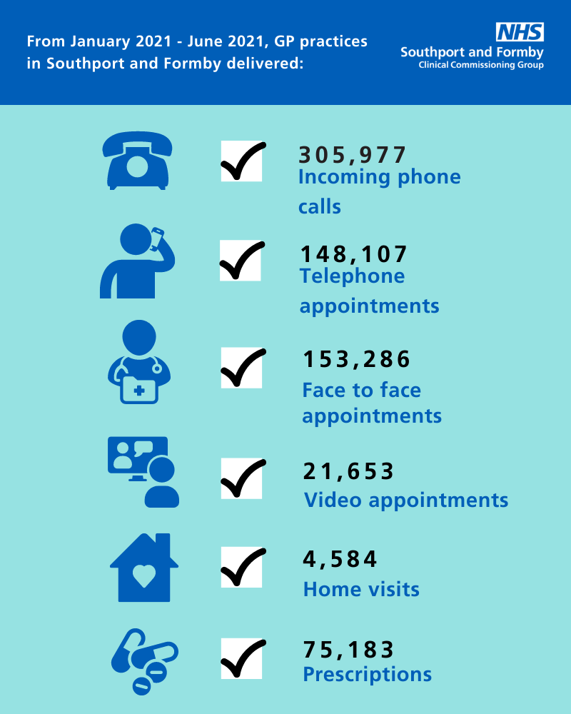
Challenges
Keeping our patients safe
Coping with rising demand
on GP practices
Busier now than we have
ever been

Slide 29
How we have been working
Covid hubs – during pandemic
Vaccination programme at some GP practices
Increased home visits
Keeping staff and patients safe -continued infection, protection and control (IPC) measures and face to face appointments only when clinically needed
Referring you to the right healthcare professional in the practice team for your needs, or another service if that is what's needed - we call this 'triage’

Slide 30
What we are hearing
From the national patient survey:
88% of Southport and Formby patients completing the national GP survey are satisfied with the care they received
73% patients said that their experience of making an appointment was good
85% were satisfied with the appointment they were offered
84% were seen / attended to within a few days of trying to book
96% patients needs were met at their last appointment
91% of the time the patient felt listened to and treated with care and concern

Slide 31
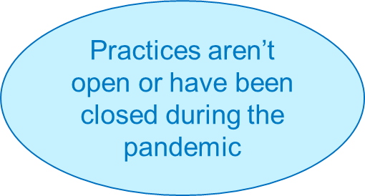
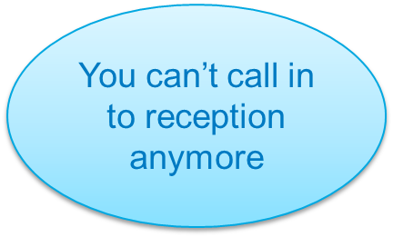
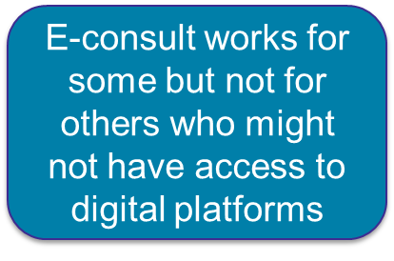
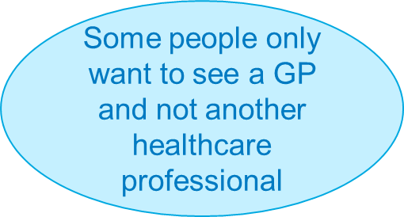
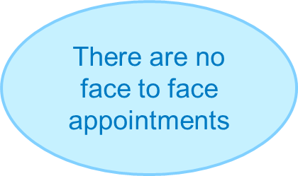
What we are hearing

Slide 32
A day in the life of
General Practice
Rob Caudwell

Slide 33
A day in the life of General Practice
Breaks - 0 mins
100% concentration needed for all activities
Day to day management of practice/discussions with practice manager needed in addition
Time for quality improvement, audit, practice planning, support for reception staff, clinical support also needed

Slide 34
Breakout sessions
We will now automatically be transferred to several breakout rooms for a discussion
Should this not happen for you, please leave the meeting and rejoin - the team will then admit you to a room
If you are unable to rejoin the meeting or are having continual technical issues, please get in touch at: communications@sefton.nhs.uk

Slide 35
Over to you
1. How have you found using your GP practice in the last year?
  (What was your experience?)
2. Have you been seen by other services, such as your community pharmacy or our weekend and evening appointment service?
3. After hearing today’s presentation will you view your practice staff and pressures they face differently?
4. Given the pressures they are under and hearing more on this today, how would you like to see your GP practice working in the future?

Slide 36
Summary of breakout sessions

Slide 37
Going forward
Blended model to manage demand
Triage will still be needed to get you to the right person
You may see other healthcare professionals, not just a GP
We will be carrying out a GP access survey very soon – you will receive details from your GP practice when they are taking part

Slide 38

Lastly…
You can find walk-in sites in Sefton and beyond using the NHS website: https://www.nhs.uk/conditions/coronavirus-covid-19/coronavirus-vaccination/find-a-walk-in-coronavirus-covid-19-vaccination-site

Slide 39
Any questions?

Slide 40
Closing poll
Rob Caudwell
Chair
NHS Southport and Formby CCG
Follow us @NHSSFCCG

Slide 41
CCG celebration video
Follow us @NHSSFCCG

Slide 42
Thank you
Our Annual Report and Accounts for 2020-2021 has more about our work. You can find it on our website www.southportandformbyccg.nhs.uk
Any further questions please email communications@sefton.nhs.uk
Follow us @NHSSFCCG

